Slide 1

Course Registration System
Notes:
Hi Everyone,
Good Morning
Before we start with the presentation today, I would like to share a small recital.
We all started as fresh graduates, underwent 3 weeks or so of rigorous training followed by what…3 weeks now of a Hands On project, and what has transpired in these days is a fact that we all are really proud of. A transformation from someone who could code, to someone who can not only code, but add value to everything he does.
So have we succeeded at becoming a Product engineer?
Hi, I am, a small part of our big team here.
I am here with my colleagues …. and ….. and we are here to give you a walkthrough of our Transformation, our Journey and the project we have been working for sometime now.

Slide 2
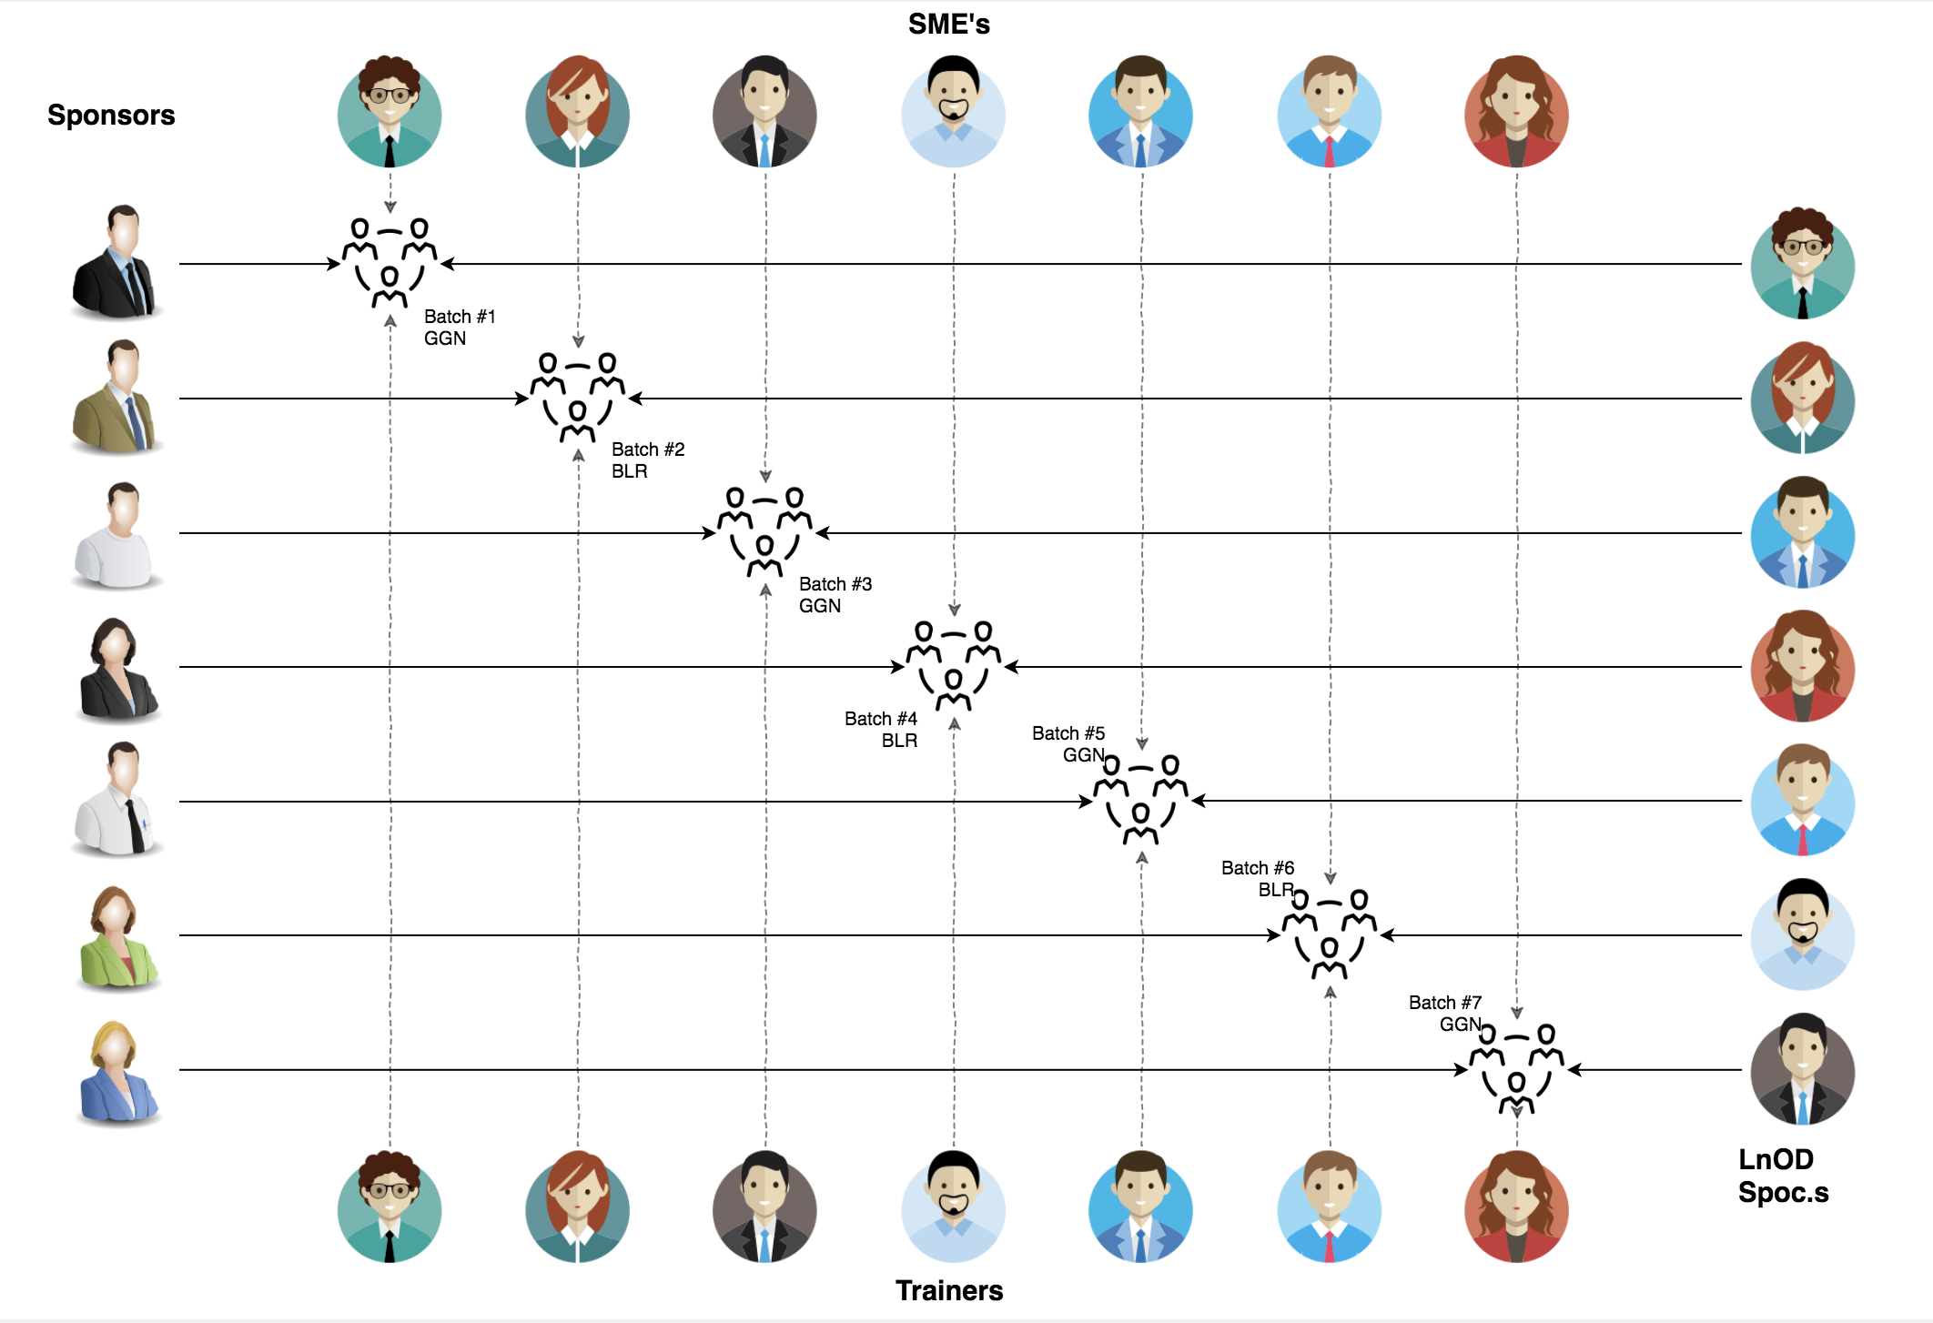
Stakeholders
Sponsors
Flipkart
SME’s
Deepika Gajraj
Sakshi (Order Trainings)
Pooja
3. Trainers
1. Amit Balyan

Slide 3
Our journey starts now
Notes:
Time – 1 min
Swati

Slide 4
ACTION PLAN
 | Modules | Description
Week 1 (March’ 22 - March’ 26) | UNIX GIT UML Diagrams | Understanding Unix and Git commands Requirement understanding and Diagram design
Week 2 (March’ 30 - April’ 5) | Java 8 Exception Handling SQL | Developing a POS Application using Java and MySQL. Understanding Java 8 features and collections
Week 3 (April’ 6 - April’ 13) | Jersey and DropWizard | REST API Development using Jersey and DropWizard framework

Slide 5

Agenda
01
Our Journey
02
Our Team
03
Team Structure
04
Problem Statement
05
Engineering Practices
06
Tech Stack
07
Development
08
Challenges & Learnings
09
Demo
10
Questions
Notes:
Time – 1 min

Slide 6

Our Journey
Notes:
Time - 2 mins

Slide 7
Demo
Testing
Process
5
Project Demo
Tools
4
Testing on Console using Postman REST Client
Comprehend
3
Decide the Technology stack for console and REST API development
2
Architecture Design
1
Understanding Project Requirements and Goals

Slide 8
3 WEEKS OF TRAINING + PROJECT DEMO
16 DAYS
160 HOURS
9600 MINUTES
576,800 SECONDS
LIMITLESS KNOWLEDGE

Slide 9

Our Team
Notes:
Time – 2 mins

Slide 10
Prince Kumar
Sahil Balhara
Sahiba Sehdev

Slide 11

Project Goals
Notes:
Time – 3 mins

Slide 12




Problem Statement
To develop a POS application and REST API for Course Registration System using JAVA wherein the students can register, add/drop course, view Report Card, professors can view courses, enrolled students, add grades and admin can manage users, add/drop courses to the course catalogue and generate students’ Report Card.
1
2
Quality
Security
3
4
Interactivity
Speed
Notes:
User satisfaction and brand value
Problem Statement

Slide 13

Engineering Practices
Notes:
Time – 5 mins

Slide 14
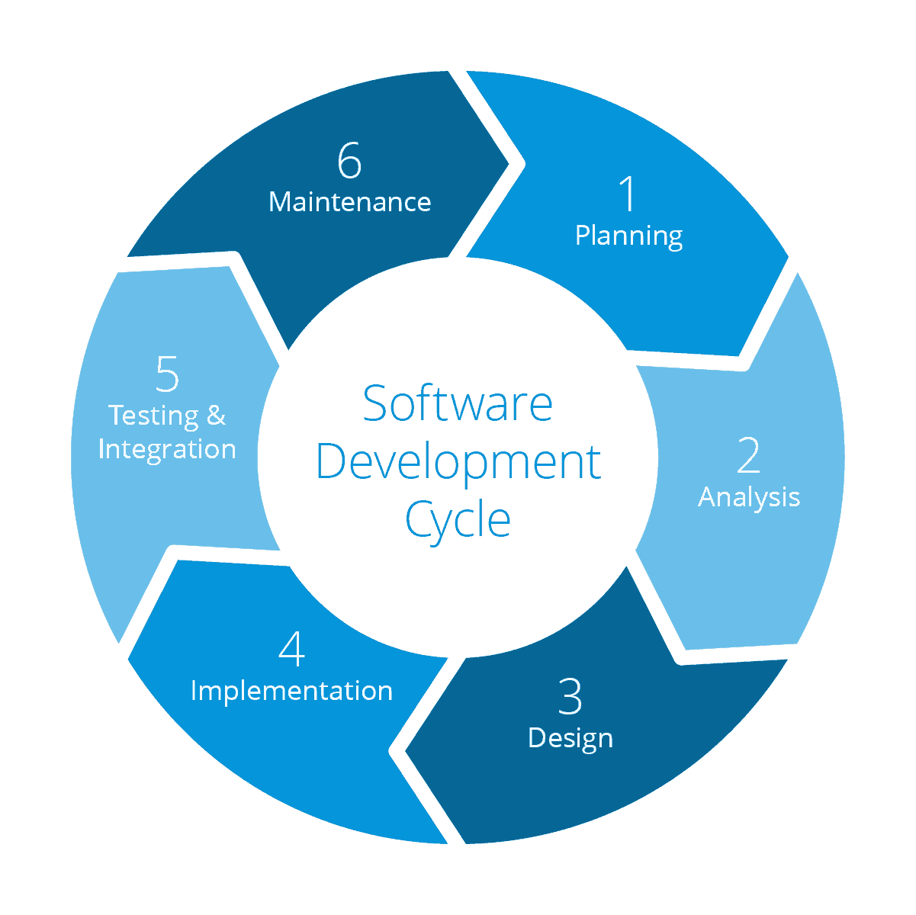
Requirement Gathering
Getting Familiar With a Testing Framework,Junit
Tech Stack Selection
UML Artifacts, Architecture Design, SOLID
Code development
Notes:
Implementation ->

Slide 15
Division of Responsibilities
Name | Responsibility
Prince Kumar | Implemented Student, User functionalities, UML Diagrams
Sahil Balhara | Implemented Professor, User functionalities, UML Diagrams
Sahiba Sehdev | Implemented Admin functionalities, User functionalities, UML Diagrams
Notes:
Name alongwith responsibilities

Slide 16

Tech Stack
Notes:
Time – 2 mins

Slide 17







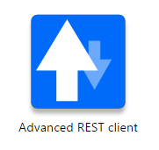






Designing
Backend
Testing
Data
SCM
UML
Core Language
Tools
SQL Database
Code Collaboration
Framework
Application Server
Notes:
Time – 1 min
Java
Maven
DropWizard
MySQL
Jersey
GitHub
Postman / ARC (Check it)
StarUML / Dia / Lucid Charts
List
Design
Backend
Testing
Tools

Slide 18

Development

Slide 19



Requirement understanding
Research and analysis
Estimation
Planning
Grooming
LLD
Development
Code Review
Commit
Integrate
Deploy
Test
Integration
Implementation

Slide 20

Challenges & Learnings
Notes:
Time – 2 mins

Slide 21
 | Challenges | Learning
Week 1 | Understanding the problem statement Collaboration issues such as merge conflicts in Git UML diagram conventions | UNIX Ubuntu Git commands UML Diagrams
Week 2 | Installation softwares on multiple environments POS application development using layered architecture | Java 8 Exception Handling SQL
Week 3 | Resolving jar and version dependencies Jersey validation Running Apache TomCat server Resolving merge conflicts on git | REST API development using Jersey and DropWizard Maven DropWizard Using git remote

Slide 22

Architecture Design
Notes:
Time – 1 min

Slide 23

POS Application
Java Main Client
Business Code
Database Code
HTTP Request
HTTP Response
Notes:
n-tier

Slide 24

Demo
Notes:
Time –
Architecture – 5 mins
NFR Dashboard – 3 mins
Demo – 10 mins
1. Show the Responsiveness and Wave tool first

Slide 25

Questions
Notes:
Time - ?

Slide 26
Thank you
Notes:
Time – After this show the testimonial video. 1 min

